Slide 1
Announcements
We will release the project today. It’s due before class during Week 10 (3/13)
This Stanford course is probably the best resource we could find.

Slide 2
Image Processing and Convolutional Neural Networks
E96: Python and Machine Learning

Slide 3
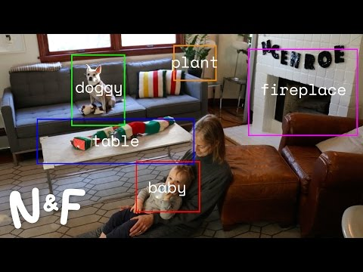
What is image processing?

Slide 4
Part I
What computers “see”

Slide 5
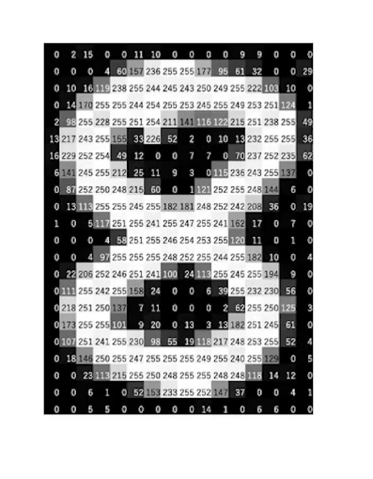
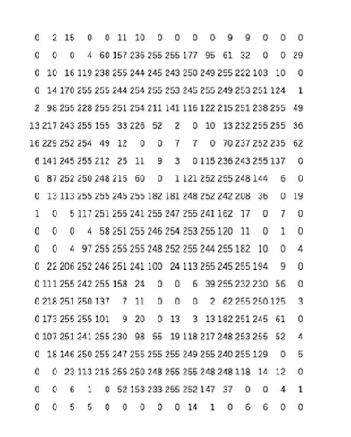
Image are NUMBERS!
What the computer sees
Playground: https://www.nosco.ch/ai/digit/classify.php

Slide 6
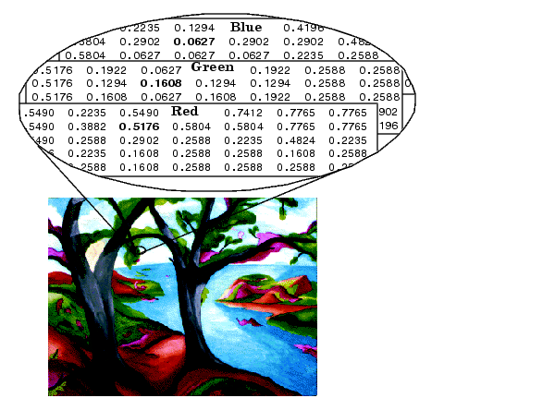
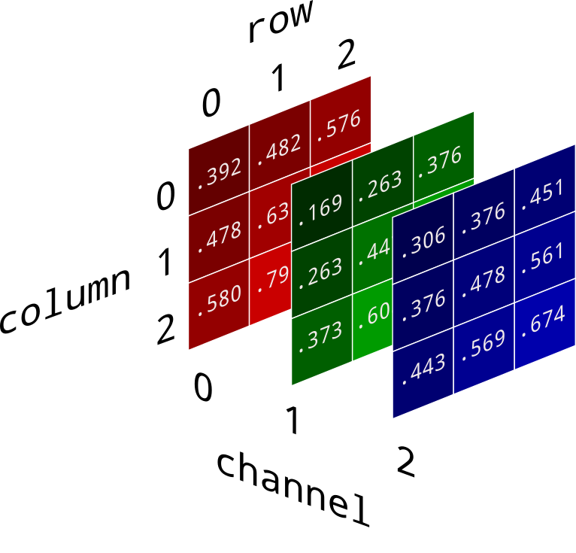
How about colorful images?
Notes:
Source: http://www.ece.northwestern.edu/local-apps/matlabhelp/toolbox/images/intro8.html

Slide 7
What can we do with those images?
Which number?
0 prob=0.2
1 prob=0.02
4 prob=0.01
8 prob=0.7
9 prob=0.07
Classification
Regression: Output variable is a continuous value.
Classification: Output variable takes class label.

Slide 8
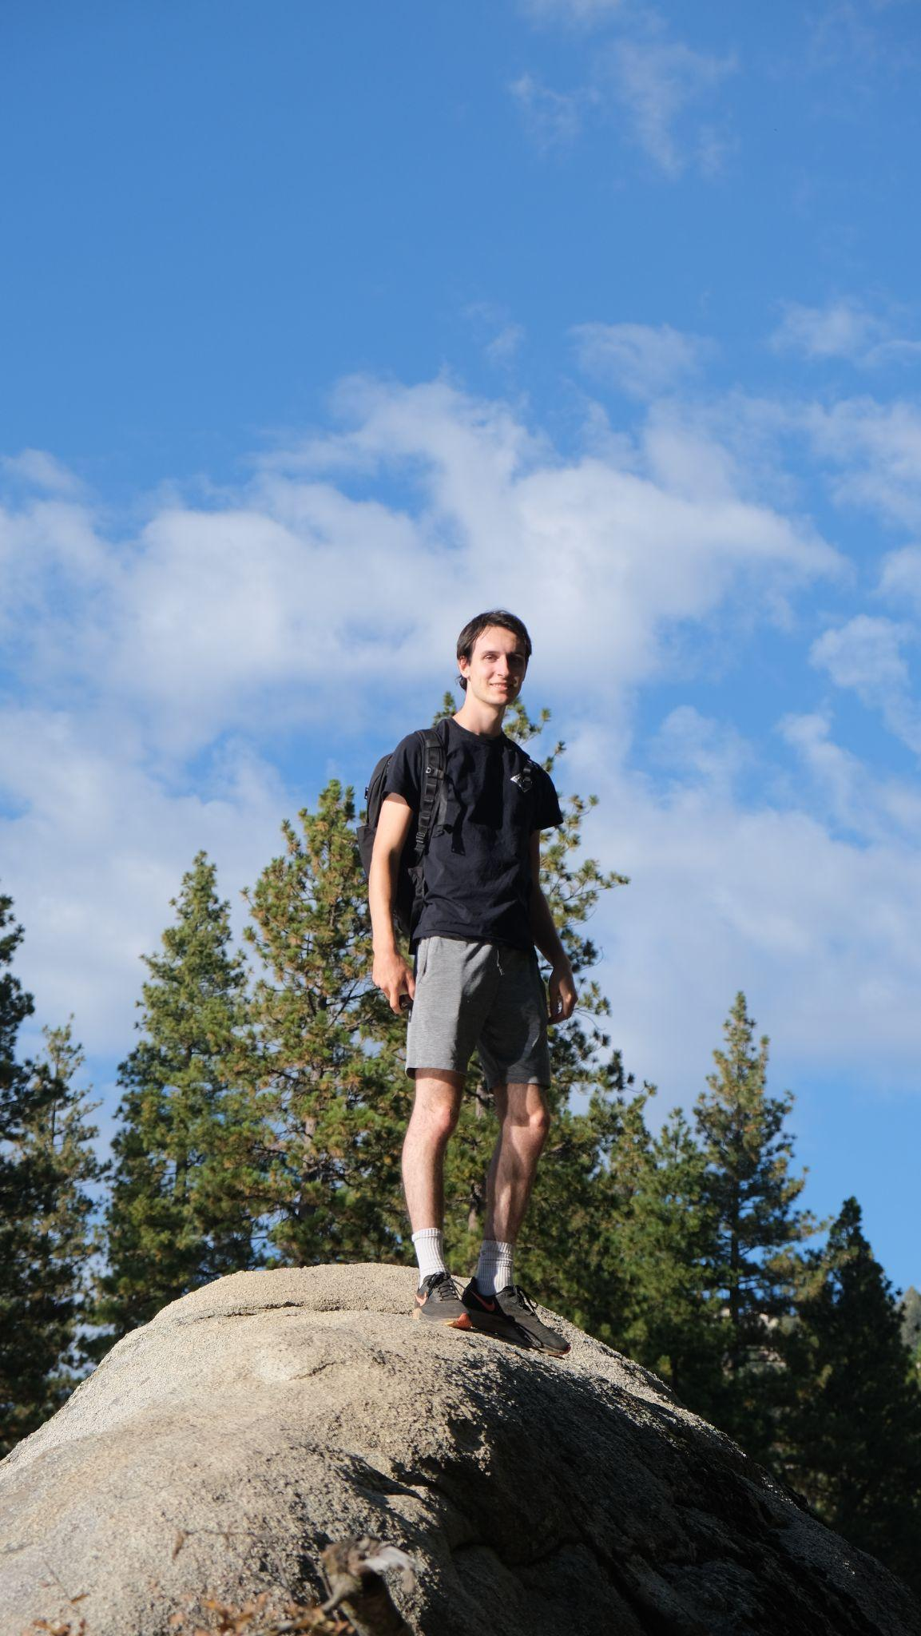
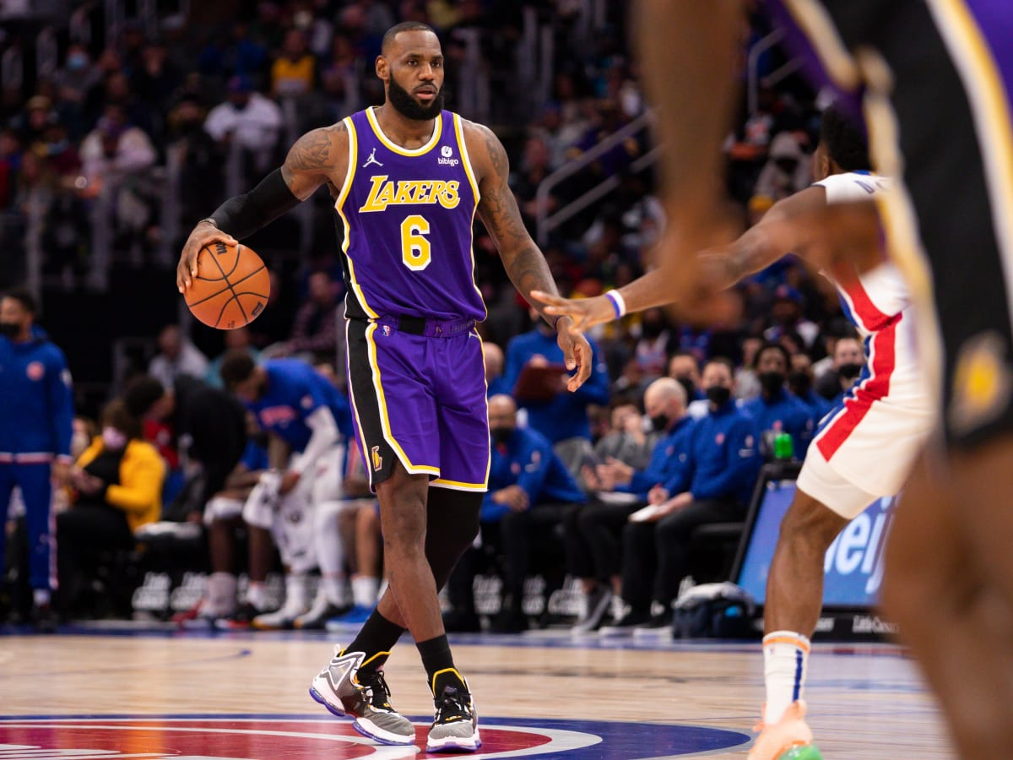
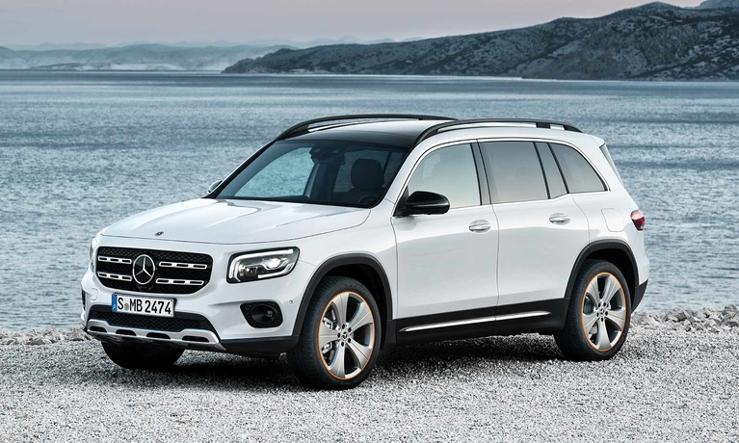
High Level Feature Detection
Ocean,
Wheels,
Headlights,
“Benz”?
Basketball,
Player,
6,
“Lebron James”?
Climber,
Rock,
Tree,
“Ben”?

Slide 9
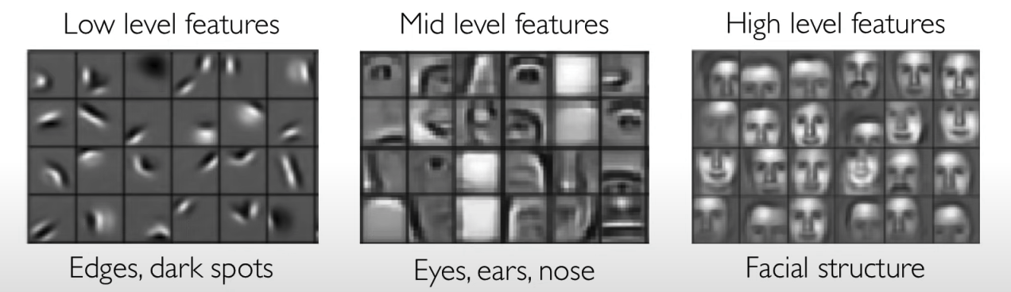
In Facial Recognition

Slide 10
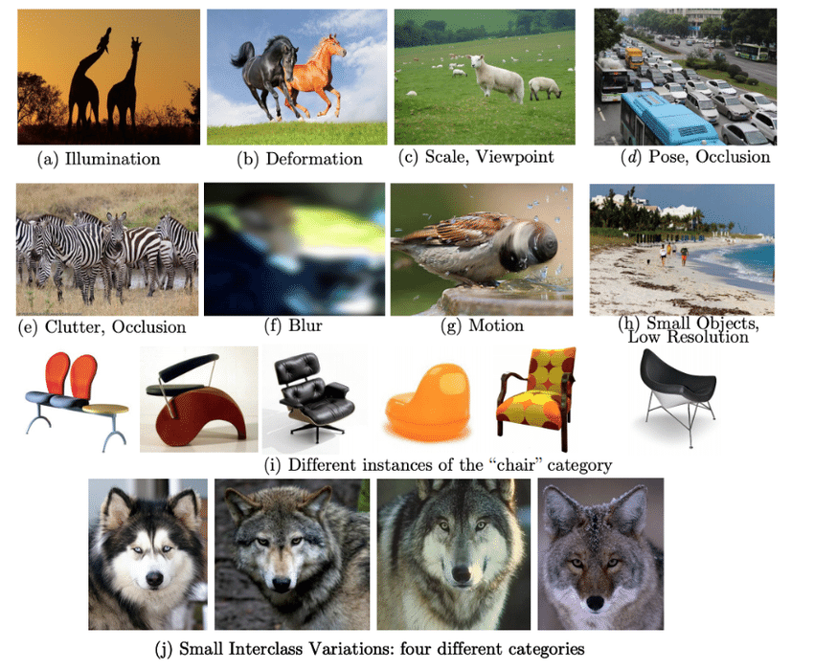
What are the challenges?
Notes:
Source: https://www.researchgate.net/figure/Challenges-in-generic-object-detection-9_fig1_340328409

Slide 11
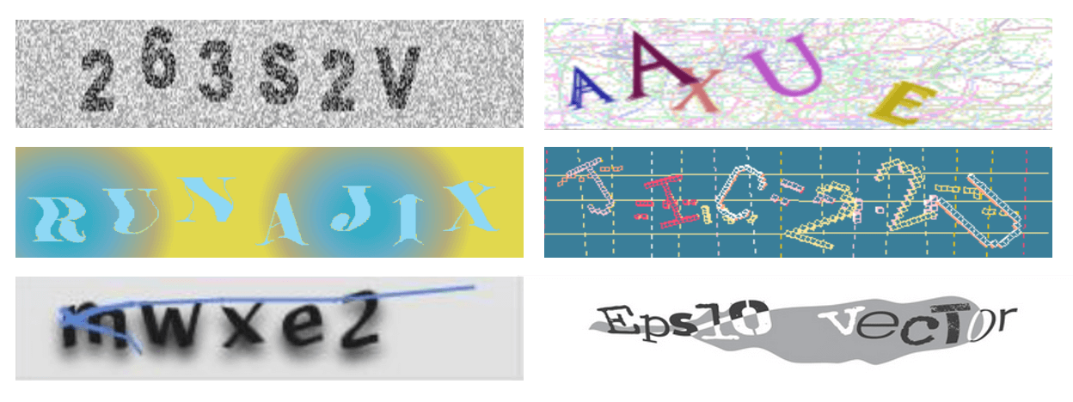
Can you give me some simpler examples?

Slide 12
Part I Summary
Images are just number matrices.
Grayscale
RGB
We hope to perform different tasks on images (or videos)!
Regression
Classification
How to process images?
Feature Extraction
Facial features

Slide 13
Part II
Learning Features

Slide 14
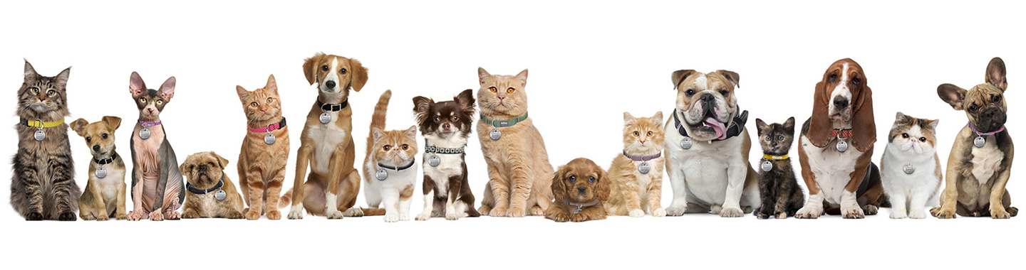
Why Convolutional Neural Network (CNN)?
The way CNN captures features is kind of similar to how we (human beings) capture and interpret an image.
Can you identify the animals in this image?

Slide 15
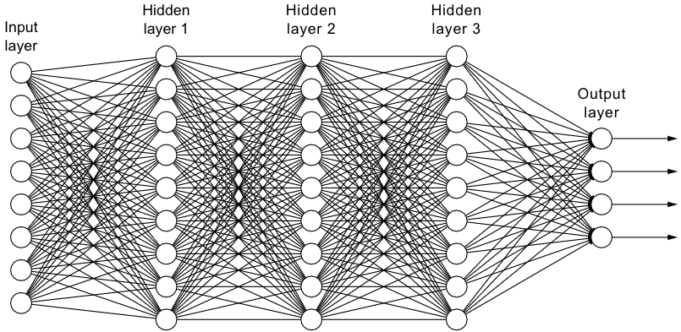
Recall from last lecture
Dense Neural Networks

Slide 16
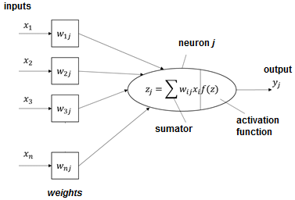
Fully Connected Neural Network
What’s wrong with FCNN?
We take in all the inputs
No spatial information
Too many parameters! Too hard to train!

Slide 17
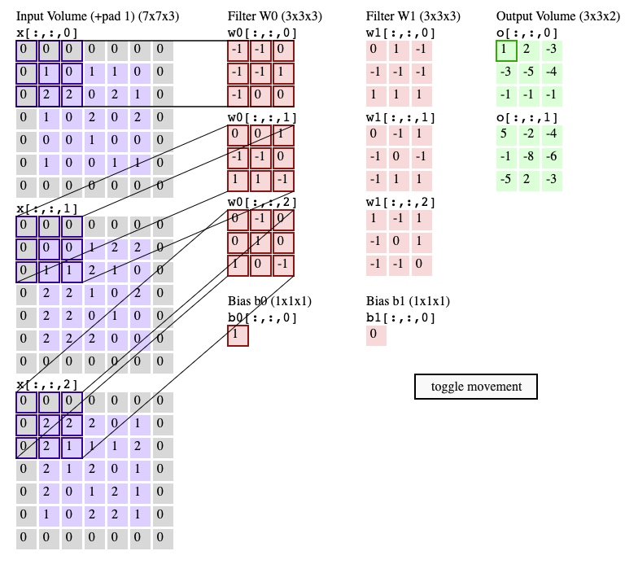
Easy Fix?
Idea:
We want a single neuron in the next layer to focus only on some of the neurons from the previous layer.
Notes:
Source: https://cs231n.github.io/convolutional-networks/#conv

Slide 18

In Practice: Convolution operation
Filter of 3x3 (kernel), 9 weights
Apply the same filter to 3x3 patches of input
Shift 1 pixel at a time
Use different filters to extract different features

Slide 19
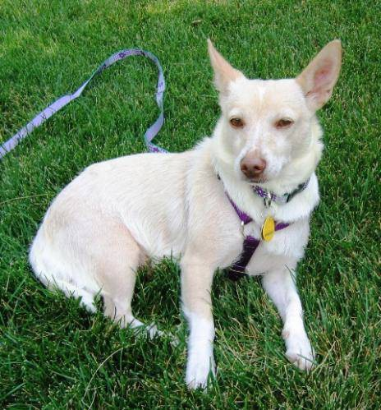

Feature Extraction Example
Size: 150 x 150 x 3
Source: https://www.analyticsvidhya.com/blog/2020/11/tutorial-how-to-visualize-feature-maps-directly-from-cnn-layers/

Slide 20
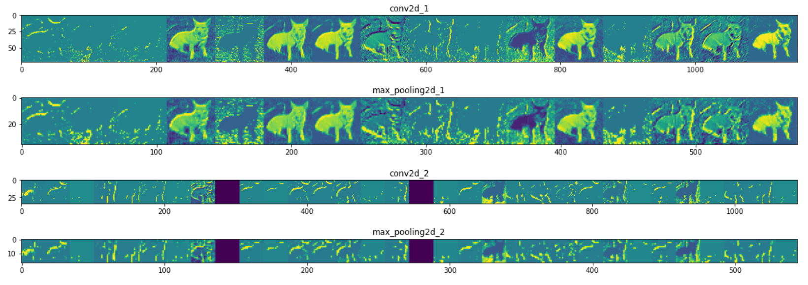
Feature Extraction Example
Source: https://www.analyticsvidhya.com/blog/2020/11/tutorial-how-to-visualize-feature-maps-directly-from-cnn-layers/

Slide 21

RGB image example
Colorful images have three channels: R(red), G(green), and B(blue).
So instead of performing “convolution” in a 2D space, we need to perform the same process in 3D.

Slide 22
Part II Summary
Intuition behind CNN
We want to extract local features first, but not too much.
We want to maintain spatial structure of the input image.
At the very end, we might want to make a decision (C/R) using the information from all pixels.

Slide 23
Part III
A Case Study

Slide 24
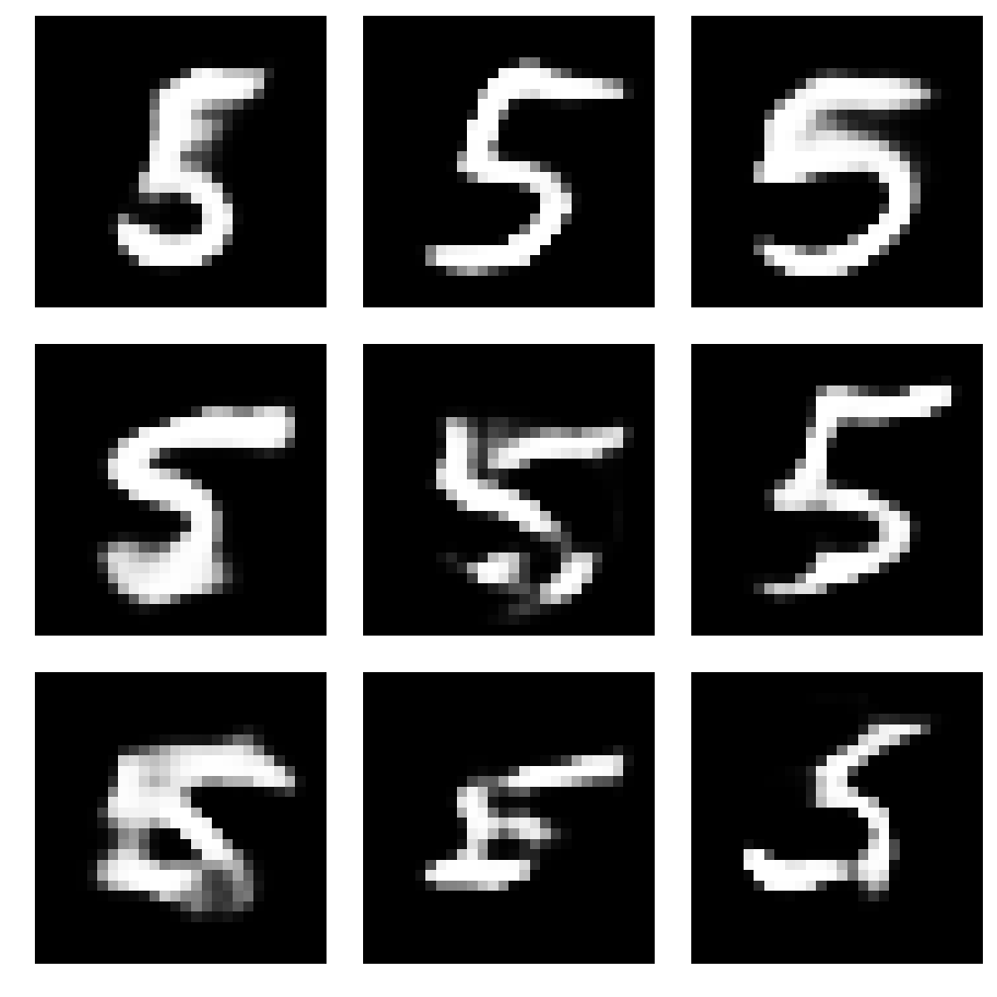
5 or 5?
Can we compare the pixel values of different 5’s ?
We want our model to be robust to image shifting, rotation, deformation…

Slide 25
Features of 5
3x3 kernels
1 | 0 | 0
0 | 1 | 0
1 | 0 | 0
0 | 0 | 0
0 | 1 | 1
0 | 1 | 0
You could have a bigger kernel and finer granularity.

Slide 26
Convolution operation
Filter of 3x3 (kernel), 9 weights
Apply the same filter to 3x3 patches of input
Shift 1 pixel at a time
Use different filters to extract different features

Slide 27
What kernel sizes are we using?

Slide 28
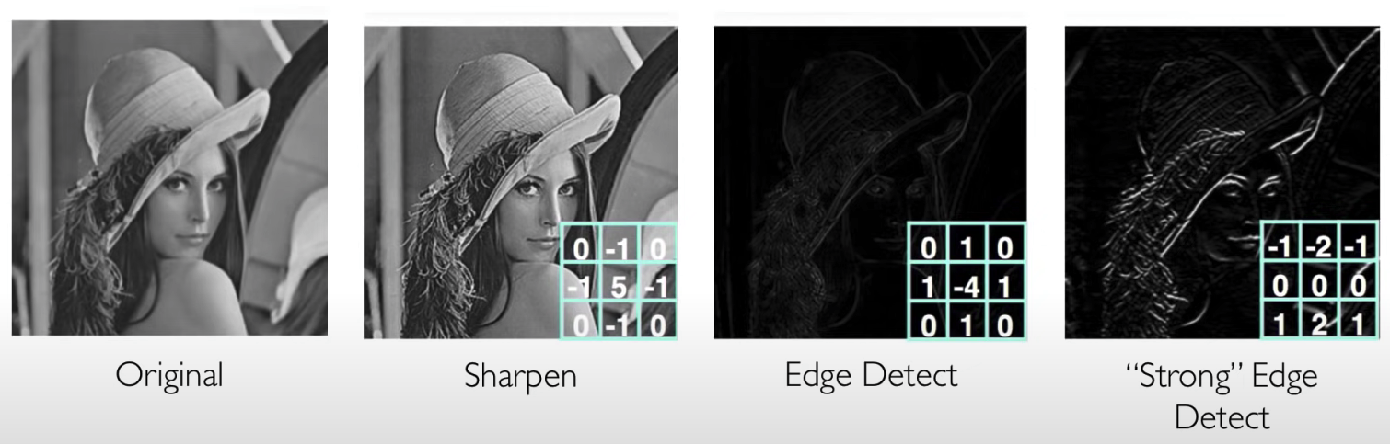
With different kernels…
Source: MIT 6.S191 course

Slide 29
Part III Summary
Feature Extraction:
Apply a set of weights (filters) to extract local features
Use multiple filters to extract multiple features
Spatially share parameters

Slide 30
Part IV
Convolutional Neural Networks

Slide 31
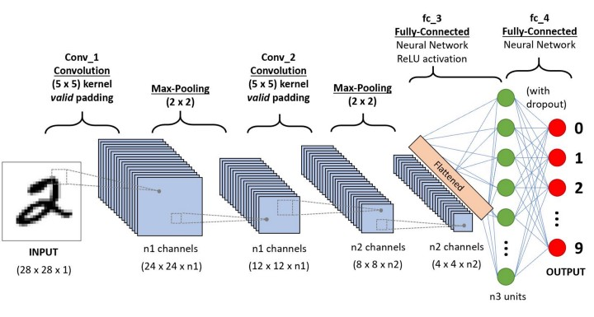
An Overview

Slide 32
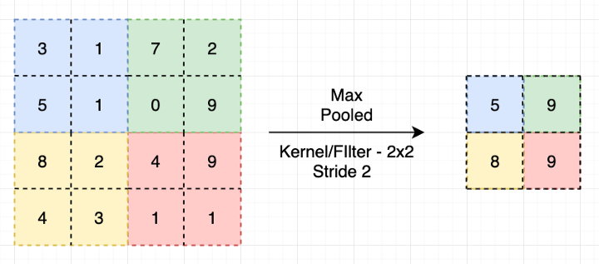
Max-Pooling
1.Reduces the number of training parameters and computation cost, thus control overfitting.
2.Make model invariant to certain distortion.
Notes:
Drop out + batch norm

Slide 33
Fully Connected Neural Network
Intuition: You don’t want to classify an image based on part of the image.
FCNN mixes all the information of that image.
Why do we need fully-connected layers at the end?

Slide 34

Part IV Summary

Slide 35
Part V
Applications

Slide 36
Tesla and Image Processing
What neural network does Tesla engineers use?

